Slide 1



SushiME
Teresa Liu
Jared Kong
Andrea Thomas

Slide 2
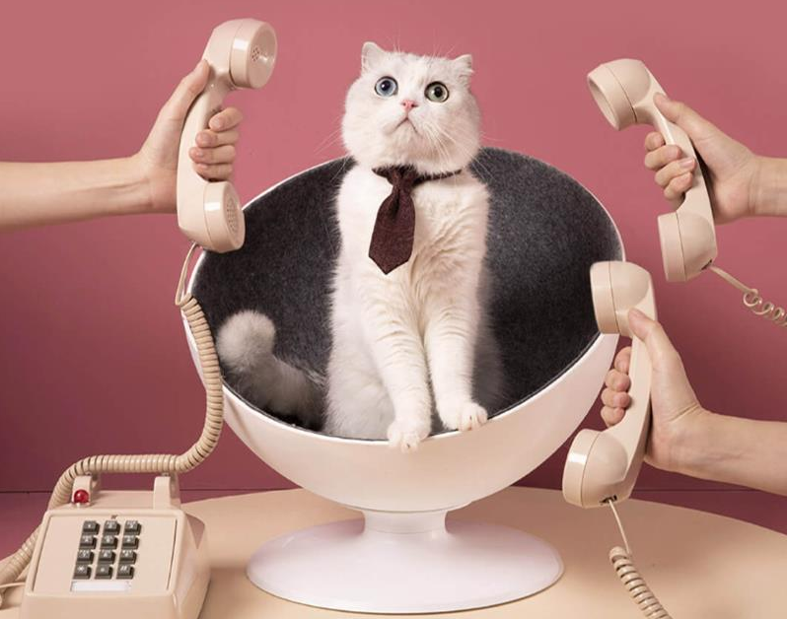

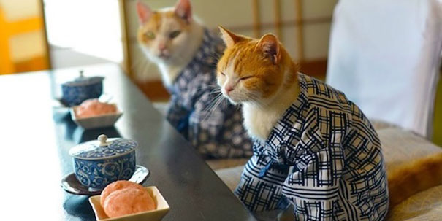
What’s Your Story?
Business Meeting?
Hot Date?
Going to Japan?

Slide 3

We’re here to make YOU look good!
Whether you’re studying for a trip or trying to impress, we make learning Japanese a breeze! SushiME acquaints you with sushi ingredients in Japanese, so you can order sushi as you please.

Slide 4

How?

Slide 5

Why?
Not all sushi restaurant menus use English to describe the ingredients-whaaat???
Confusion-what am I actually ordering?
Chopsticks are hard enough to master-why should ordering sushi be another challenge?
I feel like I’m the only one out of the loop-how can I order with confidence?

Slide 6

Let’s checkout SushiME!

Slide 7

It’s not about what it is, it’s about what it can become. -Dr. Seuss
CHALLENGES
Text to Speech API & mySQL
Git Conflicts
Handlebars
Google Maps API Key Restrictions
Fully Remote Team

Slide 8
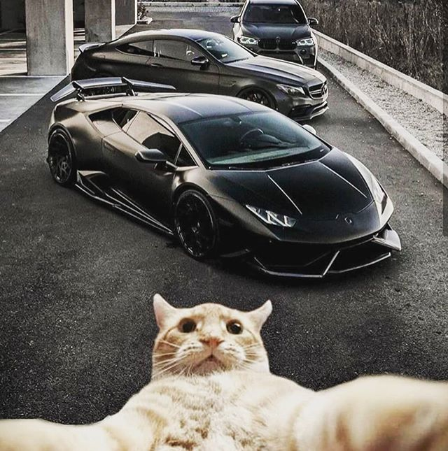
What We Learned
Expectations of grandeur result in chaos (MVP)
Planning-clear vision
Execution-delegation
Collaboration-cooperation

Slide 9
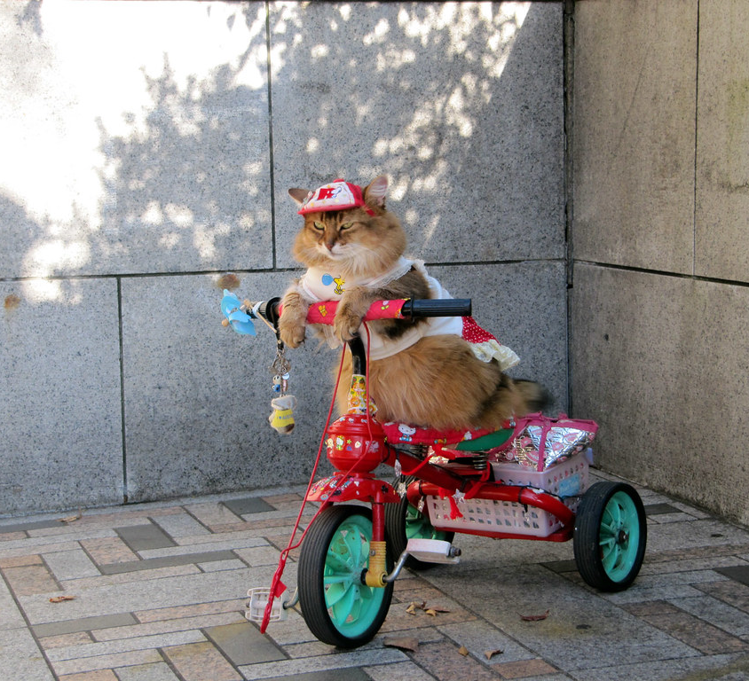
What We Achieved
MVP
API Calls
Handlebars (FINALLY)
Remote Cooperation
High Communication

Slide 10

The Future (not that we’re ready for round two)
Login w/credential authentication
Flashcards save to user account
Flashcards w/Japanese phrases
User generated flashcards

Slide 11

SHOUTOUT
Special thanks to Dane for always being available and sticking with us when we needed help!

